Slide 1
Spatial Transformer Networks

Slide 2




cat
How to achieve spatial invariance within convolutional neural networks?

Slide 3


warp
cat
p
I_{in}
I_{out}
geometric predictor
sampler
I_{in}
I_{out}
Spatial Transformer Networks
grid generator
resolves spatial variations instead of tolerating them.
p
[1] Jaderberg et al. "Spatial Transformer Networks." NIPS 2015.

Slide 4
Handwritten digit classification (MNIST)
Visualization of transformations
STN

Slide 5
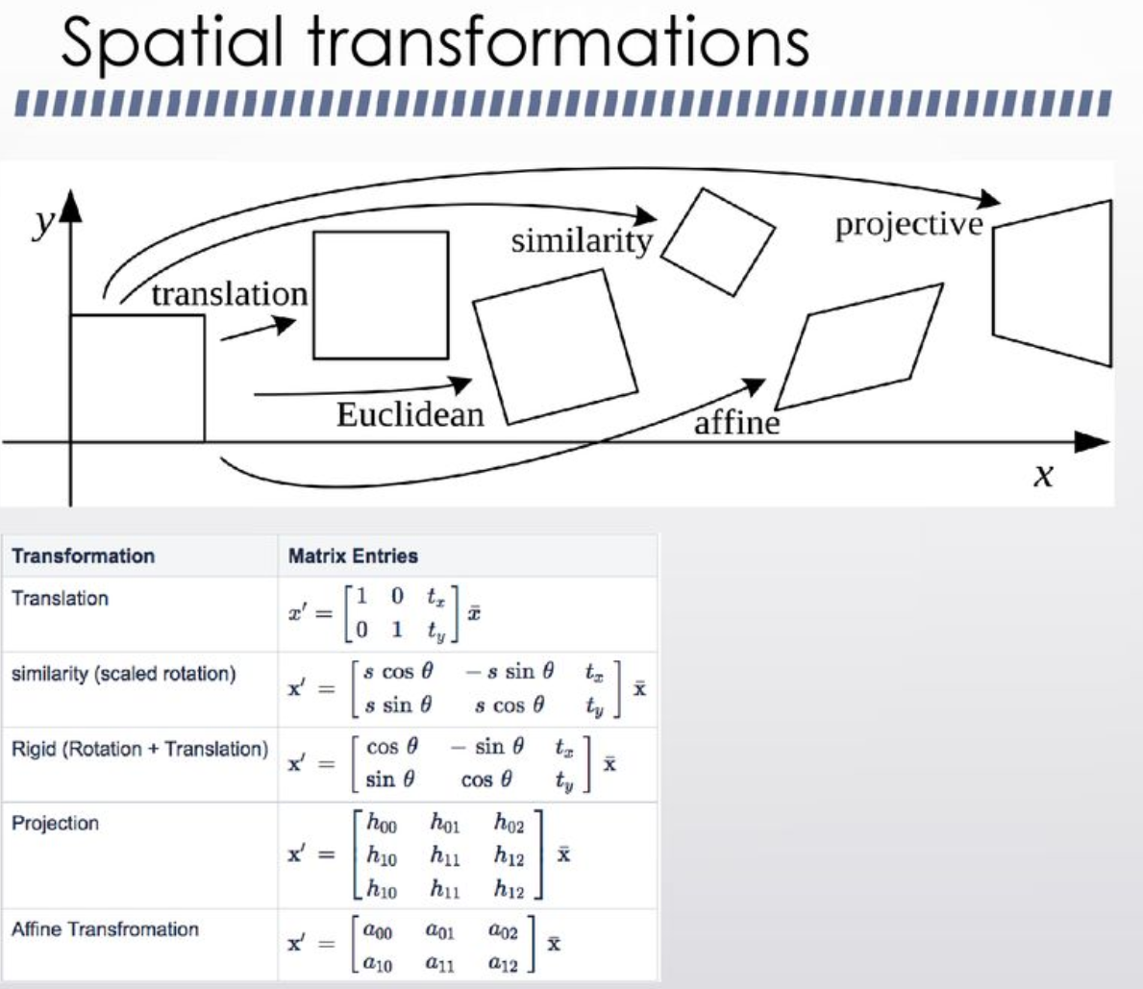

Slide 6
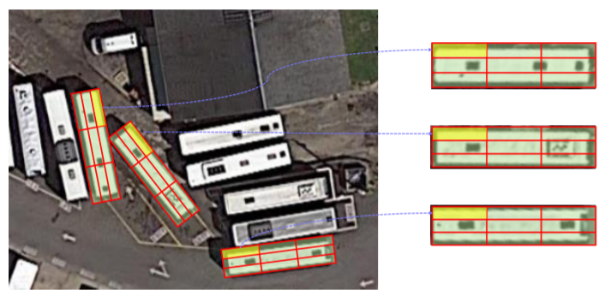

Slide 7
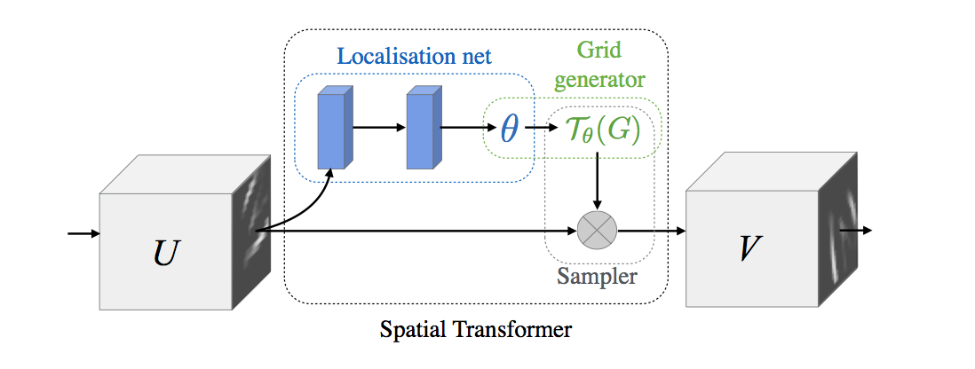
Jaderberg et al. "Spatial Transformer Networks." NIPS 2015.

Slide 8
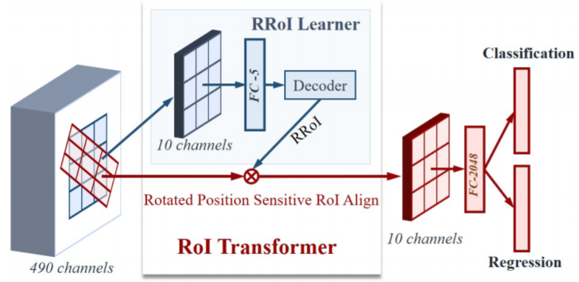
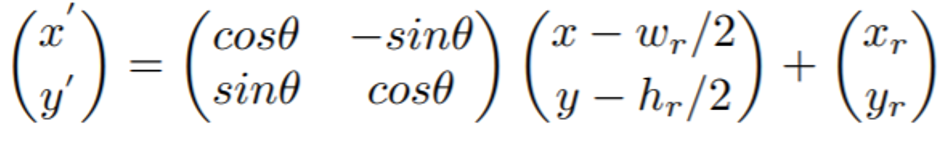
The architecture of RoI Transformer

Slide 9
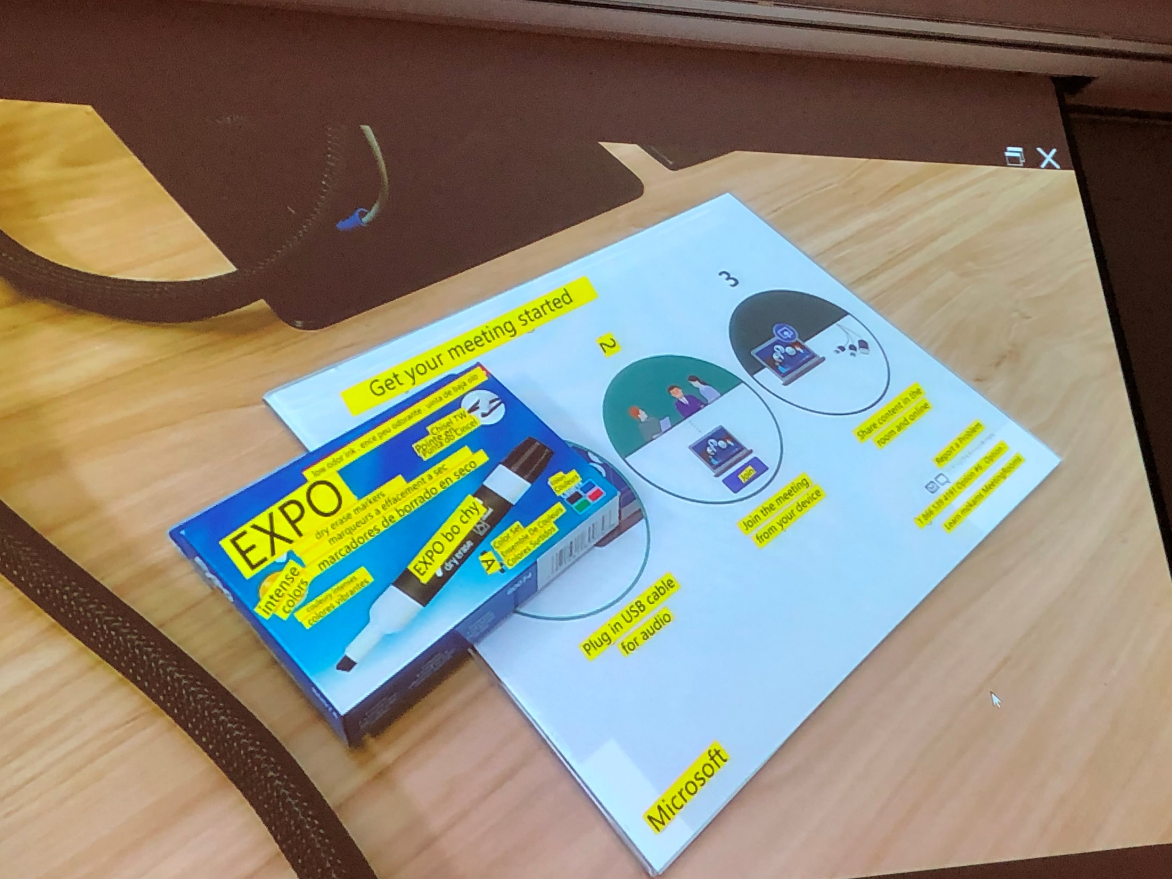

Slide 10


Slide 11
作業: 斜物件偵測
Dead line: 11/30

Slide 12
Learning RoI Transformer for Oriented Object Detection in Aerial Images
2019 CVPR
Jian Ding, Nan Xue, Yang Long, Gui-Song Xia∗ , Qikai Lu

